Slide 1

Impact of machine learning in Healthcare
Courtney Woods

Slide 2



Agenda
What is the impact of machine learning in Healthcare and why is it important.
What is Supervised Learning?
Analyzing supervised learning with Covid cases.
Impact of data? What are the consequences?
Classification tree

Slide 3




Impact of machine learning in Healthcare
Machine learning in healthcare can have very positive impacts on machine learning.
The biggest one is that machine learning algorithms are designed to hold large data sets and with patients’ files that’s all it is. As proven recently, It can predict a 92% accuracy in the mortality of COVID-19 patients.
Can aide in developing a precise treatment plan by simplifying the search for solutions to a lot of medica cases

Slide 4
Impact of machine learning in Healthcare
Other examples machine learning effects in healthcare :
Clinical decision support systems
Smart recordkeeping
Machine learning in medical imaging
Robotic surgery
Behavior adjustments
Predictive approach to treatment
Data Collection
Drug discovery and production
Elderly and lo mobility groups care
Infectious disease outbreak predictions
Clinical research

Slide 5

Supervised learning?
Supervised learning is a subcategory in machine learning. It uses datasets that are labeled to train algorithms to classify data or predict outcomes accurately. When it received more information, the data is adjusted, weighted, and fitted appropriately.

Slide 6
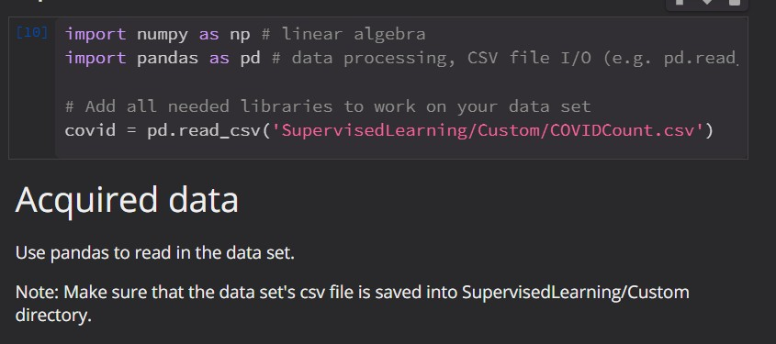
How does supervised learning work?
Acquire the data
We start off with acquiring the dataset we want to use and import it into python via pandas.

Slide 7
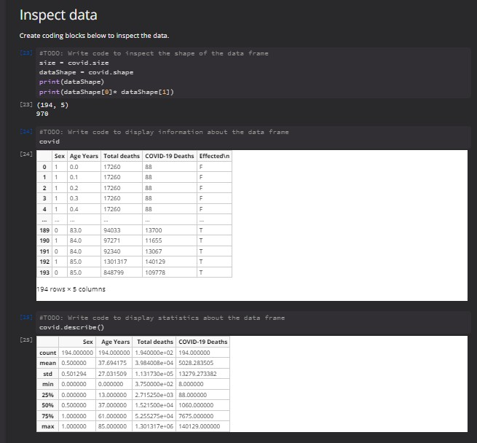
How does supervised learning work?
Inspect the data
We inspect the data by checking the following:
Data shape
Displays row x column count
Describe function
Computes and displays the summary statistics

Slide 8
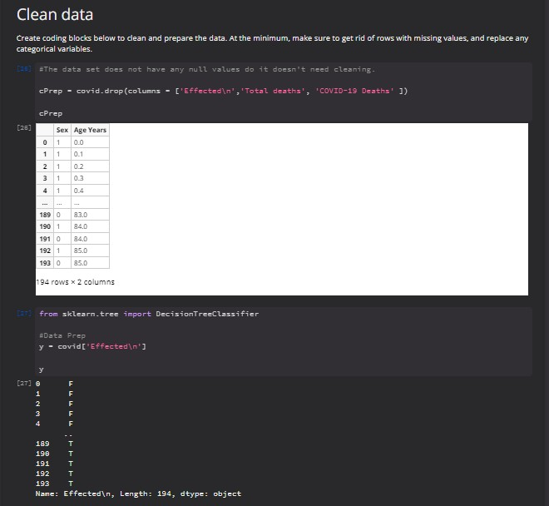
How does supervised learning work?
Clean the data
We “clean” the data
By this we can remove whole columns from the data chart.
In this case; we removed “Covid Deaths” and “Effected” from the data set. As you can see, it only has “Sex” and “Age Years” left in the data set.
After we set y to the “Effect” column information and then display it.

Slide 9
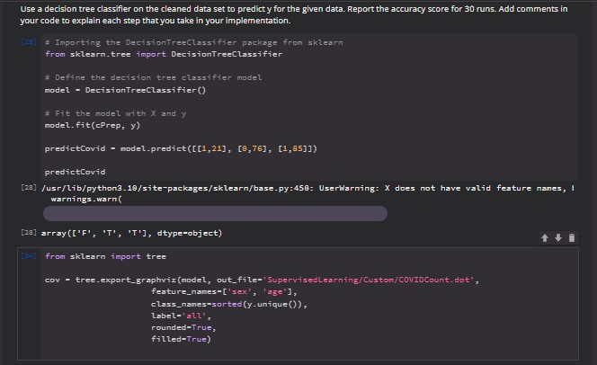
How does supervised learning work?
Create Decision Tree and Test
Import the DecisionTreeClassifier
Define the decision tree classifier and then fit the model to the current information we have.
As you can see at the bottom, we export the decision tree into a “.dot” file.
Test the data
We, also, test the data. As you can see we set the information of the testing model as “predictCovid” and put in possible variables.
It returns an array of a predicted outcome of what each output is likely to have

Slide 10
Impacts of this data?
One of the biggest impacts this data, and data like this has is that is predicts the possibilities of sex and age range is more likely to be affected that results in death by COVID-19.
As you can see from the start of the COVID epidemic starting in 2020, hospitals were able to deduce that the elderly were terminally affected by the sickness.

Slide 11
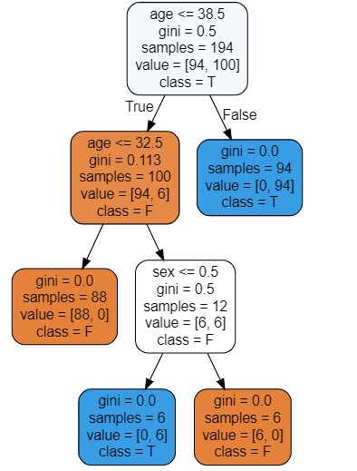
DecisionTreeClassifier

Slide 12

Summary
Machine learning has a plethora of possibilities to give in the healthcare field. As you can see, healthcare means is progressing bit by bit to better care for and aid their patients effectively and with good results.
Supervised learning doesn’t just help with COVID like cases, it is also used in all forms of cancers as well. That’s why we can know that when men reach 40, they become at a high risk of prostate cancer, thus why around these times they advise you to do annual tests for them. or why women ranged between the ages of 25 to 65 are required to take an HPV test every 5 years for early detection of cervical cancer.
Thanks to supervised learning and the analyzation of these patient’s information and data sets. They were able to pinpoint this. Who knows what other possibilities machine learning can open in our healthcare system.

Slide 13


Thank You
“American Cancer Society Recommendations for Prostate Cancer Early Detection.” American Cancer Society, 23 Apr. 2021, https://www.cancer.org/cancer/prostate-cancer/detection-diagnosis-staging/acs-recommendations.html#:~:text=The%20discussion%20about%20screening%20should,risk%20of%20developing%20prostate%20cancer.
“Conditions Contributing to Covid-19 Deaths, by State and Age, Provisional 2020-2022.” Centers for Disease Control and Prevention, National Center for Health Statistics, 8 May 2020, https://data.cdc.gov/NCHS/Conditions-Contributing-to-COVID-19-Deaths-by-Stat/hk9y-quqm.
IBM Cloud Education. “What Is Supervised Learning?” IBM, IBM Cloud Education, 19 Aug. 2020, https://www.ibm.com/cloud/learn/supervised-learning.
Tkachenko, Natalie. “Machine Learning in Healthcare: 12 Real-World Use Cases – Nix United.” NIX United – Custom Software Development Company in US, NIX United, 6 Oct. 2021, https://nix-united.com/blog/machine-learning-in-healthcare-12-real-world-use-cases-to-know/.

